Slide 1
Does Higher Population Lead to Higher Emissions?
Dsc 530 Term Project – Stewart wilson

Slide 2
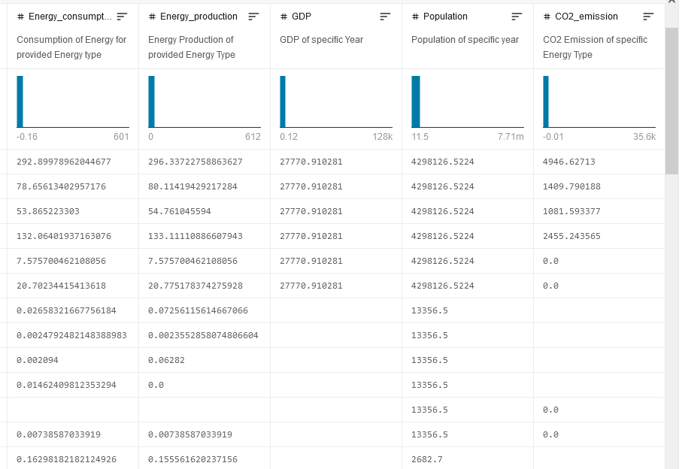
Dataset and Variables
Dataset – “Countries CO2 Emission and more…”
Found on Kaggle
Variables Used:
GDP - Countries GDP at purchasing power parities, measured (Billion 2015$ PPP)
Population - Population of specific Country, measured (Mperson)
CO2_emission - The amount of C02 emitted, measured (MMtonnes CO2)
Energy_consumption - Amount of Consumption for the specific energy source, measured (quad Btu)
Energy_production - Amount of Production for the specific energy source, measured (quad Btu)

Slide 3

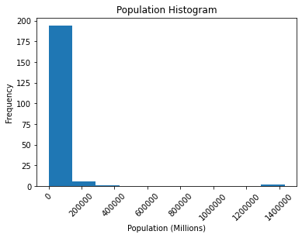
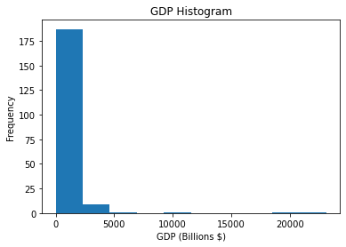
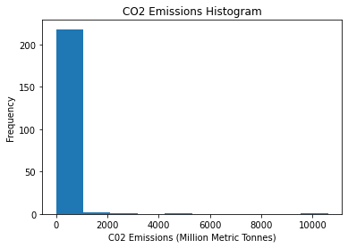
Variables Histograms

Slide 4
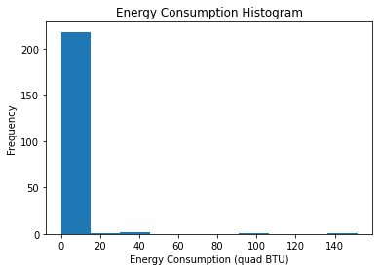
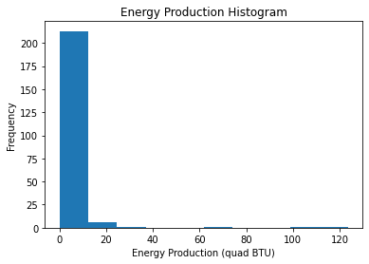
(Continued)

Slide 5
Histogram Analysis
All histograms were heavily skewed
None were normal
Results indicative of large disparities between countries when it comes to population, GDP, emissions, energy production, and energy consumption
These disparities led to extreme outliers
However, it is these outliers that we are most interested in
Looking for high population and high emissions
So we will leave them be for ow

Slide 6
More Descriptive Characteristics*
GDP (Billions $)
Mean | Spread | Tails
638.45 | 5,468,357.32 | Left Tail: 1.06 Right Tail: 19,925.43
Population (Millions)
Mean | Spread | Tails
38,003.10 | 20,696,274,720.74 | Left Tail: 57.22 Right Tail: 1,368,140
CO2 (Million Metric Tons)
Mean | Spread | Tails
159.57 | 673,858.09 | Left Tail: 0.009821 Right Tail:5277.192754

Slide 7
(Continued)
Energy Consumption (quad BTU)
Mean | Spread | Tails
2.69 | 160.75 | Right Tail: 0.0 Left Tail: 100.43
Energy Production (quad BTU)
Mean | Spread | Tails
2.74 | 142.73 | Right Tail: 0.0 Left Tail: 101.40
*No mode for any variable since each value was unique and there were no duplicates

Slide 8
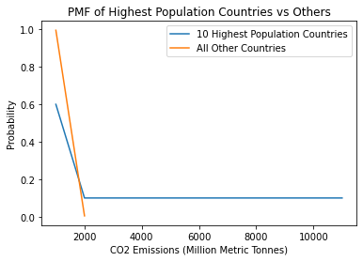
Comparing Emissions in Most Populous Countries vs All Others
Dataset was split into 2 data frames
One with countries with top 10 highest population
One with all other countries
PMF calculated for them both and shown
Countries with higher population significantly more likely to have higher emissions
To such an extent that all emissions greater than 3000 are result of 10 most populous countries

Slide 9
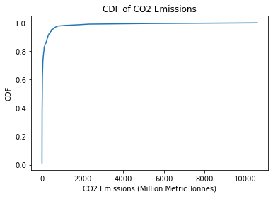
CO2 Emissions CDF
99% of countries emissions are below 2500 mmt yearly
Clear that population plays some relational role with CO2 emissions

Slide 10
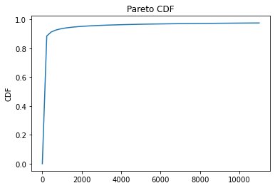
Pareto Modeling Distribution
The Pareto model is a good match for the CO2 Emissions CDF
Suggested by the complement to the CDF being a straight line
This gives possible insight into the nature of why the distribution of CO2 emissions falls the way it does
Preferential attachment process

Slide 11
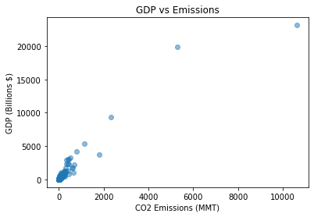
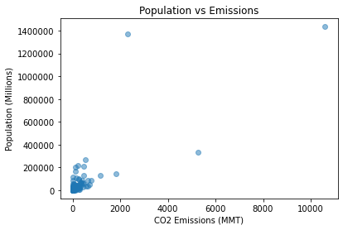
Correlation Analysis

Slide 12
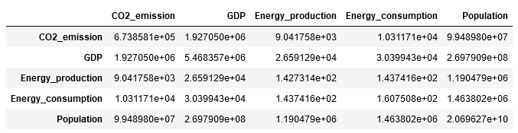
Covariance Matrix
Covariances are all positive
This tells us the direction of the relationship, but not its strength since the units of measurement differ

Slide 13
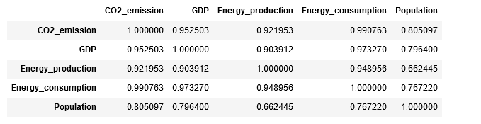
Correlation Matrix
Relationship between variables seems linear, so Pearson’s correlation is sufficient
Positive correlation between CO2 Emissions and all other variables
Highest correlation was between Energy Consumption and CO2 Emissions
Intuitively makes sense: more fossil fuels burned = more emissions
Strength between population and emissions is clear
Yet causality is not certain
Could be a 3rd variable at play
Or perhaps emissions lead to higher population

Slide 14
Hypothesis Test
Correlation Permute Test Performed
Null Hypothesis: Higher population has no effect on emissions
Random permutation of emissions data set is taken
Correlation is computed with this random data set
Hypothesis Test performed on resulting test statistic
Results
P-Value is 0.0
There was no chance that relationship between population and emissions was by chance
Null hypothesis can be rejected
Population has a significant statistical effect on CO2 Emissions

Slide 15
Regression Analysis
Two regressions analyses performed
Predictor: Population, Outcome: CO2 Emissions
Intercept: -7.52
Slope: .0048
R-Squared: .648
Predictor: GDP, Outcome: CO2 Emissions
Intercept: -47.20
Slope: .3524
R-Squared .907

Slide 16
Regression Analysis Conclusion
GDP has a much greater effect on C02 emissions than population does
GDP accounts for 90% of variance in CO2
Suggesting that while population does have a significant effect on CO2 emissions, GDP has a greater one
Problem with this analysis: Multicollinearity
Since GDP and Population are also correlated, this can lead to discrepancies in results
Can also mean the model does not generalize to the greater population

